Slide 1
Sentiment Analysis of Women's Clothing Reviews
Prepared by: Raniya Ebrahim
Date: 05/04/2025

Slide 2
INTRODUCTION
Problem Statement:
Customers express opinions in reviews, but manual analysis is time-consuming.
Businesses need actionable insights to improve products/services.
Why It Matters:
95% of shoppers read reviews before purchasing.
Sentiment analysis automates feedback interpretation, driving data-driven decisions.
ML Solution:
Classify reviews into Positive, Neutral, or Negative using NLP and ML.

Slide 3
OBJECTIVES
Analyze 23000 + reviews to identify sentiment trends.
Predict sentiment from text and rating data.
Recommend improvements based on insights (e.g., product categories needing attention)

Slide 4
DATASET OVERVIEW
Source: Women’s Clothing E-Commerce Reviews (Kaggle)
Size: 22,641 reviews after cleaning (9 features).
Key Features:
Review Text, Rating, Age, Recommended IND, Department Name.
Target: Sentiment (derived from Rating).
Challenges:
Missing values in Title (3,810) and Review Text (845).
Class imbalance (82.1% Positive reviews).

Slide 5
METHODOLOGY
Workflow:
Data Cleaning: Handle missing values, remove duplicates.
Feature Engineering: Create Sentiment labels and Review_Length.
Text Preprocessing: Lowercase, remove punctuation, TF-IDF vectorization.
Model Training: Logistic Regression vs. Random Forest.
Evaluation :Accuracy, Precision, Recall, F1-Score
Visualization :Power BI + Word Clouds + Confusion Matrix

Slide 6
MODEL SELECTION & IMPLEMENTATION
Algorithms Used:
Logistic Regression
Random Forest
Why These Models?
Logistic Regression: Easy to explain, making it a great baseline for classification problems
Random Forest: Handles Nonlinear Relationships great for capturing complex patterns in the data
Training Process:
Train-Test Split: 80% training, 20% testing
TF-IDF used for converting text into numerical vectors

Slide 7
Evaluation & Results
Evaluation Used:
Accuracy, Precision, Recall, F1-Score
Model comparison:
Model | Accuracy
Logistic Regression | 0.8211
Random Forest | 0.7924

Slide 8
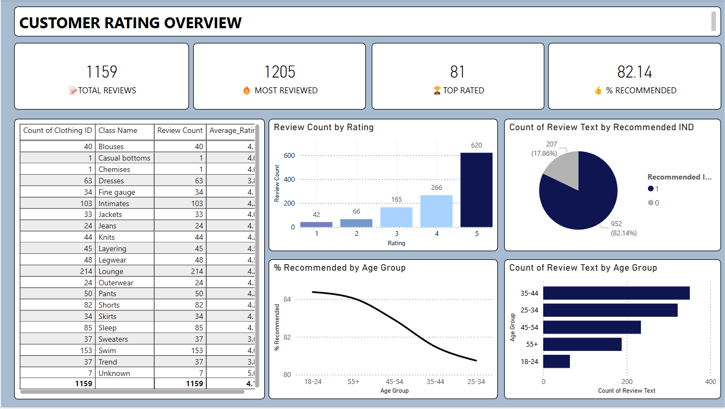
DASHBOARD OVERVIEW

Slide 9
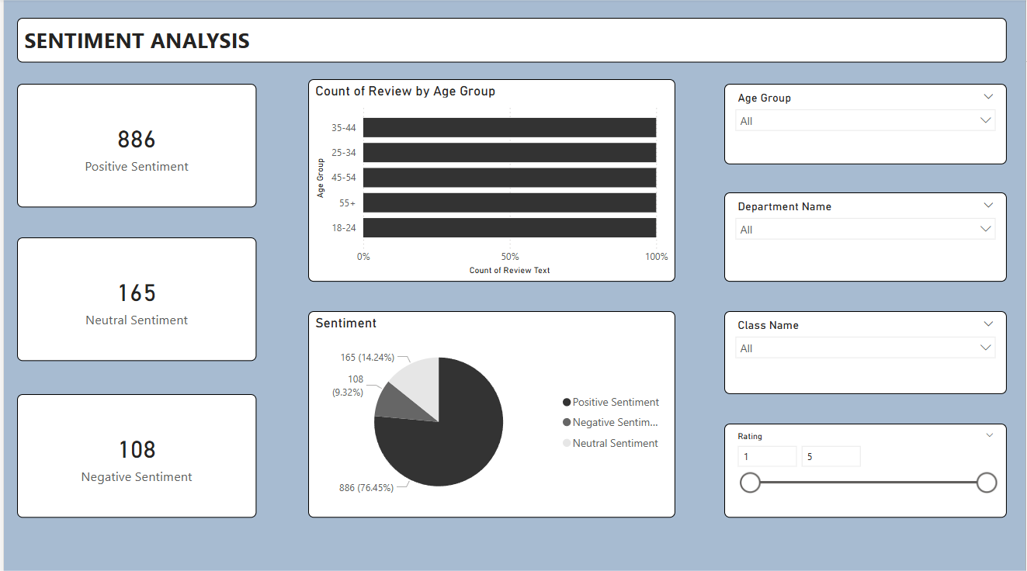

Slide 10
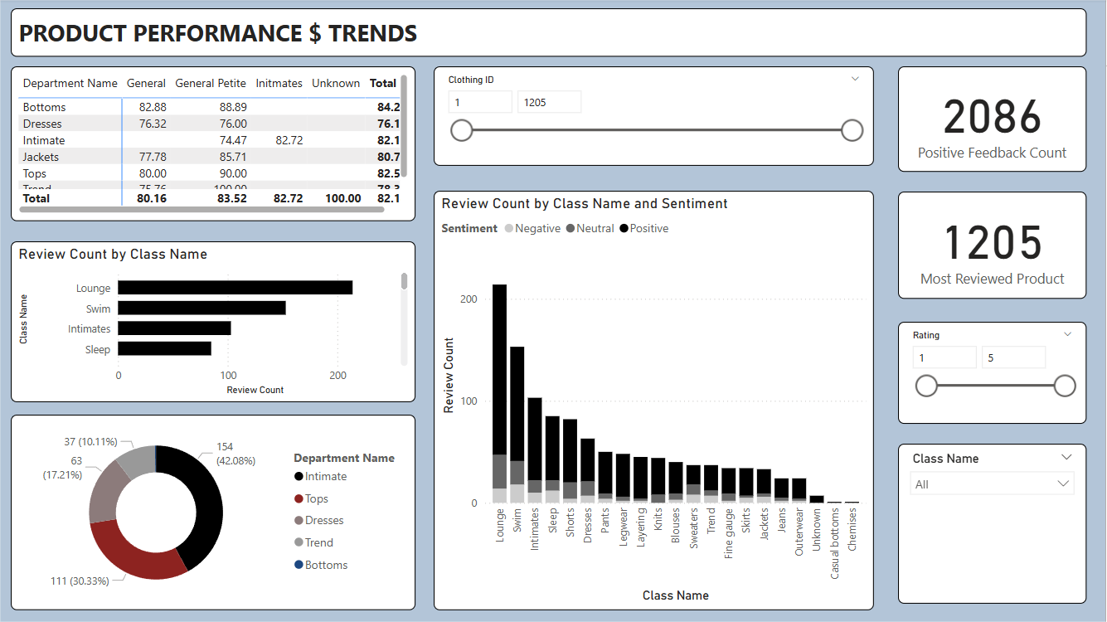

Slide 11
Key Insights & Analysis
Positive Reviews Dominate Over 75% of reviews are positive, indicating a generally satisfied customer base.
Age Factor Most reviewers are in the 30–45 age group, showing higher engagement from mid-aged women.
Product Popularity Certain classes like Dresses, Knits, and Blouses have significantly more reviews — indicating popular categories.

Slide 12
Challenges & Limitations
Text Preprocessing Complexity Cleaning and standardizing user-generated text (e.g., spelling errors, informal language) was time-consuming.
Imbalanced Sentiment Distribution The dataset had a bias toward positive reviews, making it harder to train a balanced model
Limited Context Understanding
TF-IDF + Logistic Regression / Random Forest lacks deep contextual understanding

Slide 13
CONCLUSION
Performed Sentiment Analysis on over 22K+ clothing reviews.
Created a custom Positive / Neutral / Negative sentiment label from ratings.
Logistic Regression outperformed Random Forest, achieving ~82% accuracy.
Extracted actionable insights on product preferences and customer satisfaction.

